Slide 1

DEPARTMENT OF COMPUTER SCIENCE AND ENGINEERING
TRAFFIC MANAGEMENT
TEAM NAME: TEAM MEMBERS:
Proj_224783_Team_6 MANCHU PALLAVI(113321104055)
MANNEM HEMA SRI(113321104056)
MEESALA PRAVALLIKA(113321104057)
MEGHAA V(113321104058)

Slide 2
PROJECT OBJECTIVES
The objectives of a traffic management project typically revolve around improving the flow of traffic, enhancing safety, reducing congestion, and optimizing the use of transportation infrastructure. Here are some common project objectives for traffic management:
Reduce Congestion: One of the primary objectives is to alleviate traffic congestion in urban areas. This may involve implementing strategies like intelligent traffic signal control, lane management, and congestion pricing.
Enhance Safety: Improving road safety is a critical goal. Projects may aim to reduce accidents and fatalities through measures such as improved road design, better signage, and traffic calming measures.
Optimize Traffic Flow: The project may seek to optimize the flow of traffic by using real-time data and adaptive traffic signal systems. This can help reduce travel times and fuel consumption.
Promote Sustainable Transportation: Encourage the use of public transportation, cycling, and walking to reduce the number of vehicles on the road and minimize environmental impact.
Reduce Emissions: Implement measures to reduce vehicle emissions, such as encouraging the use of electric vehicles, promoting carpooling, and optimizing traffic to reduce idle times.

Slide 3
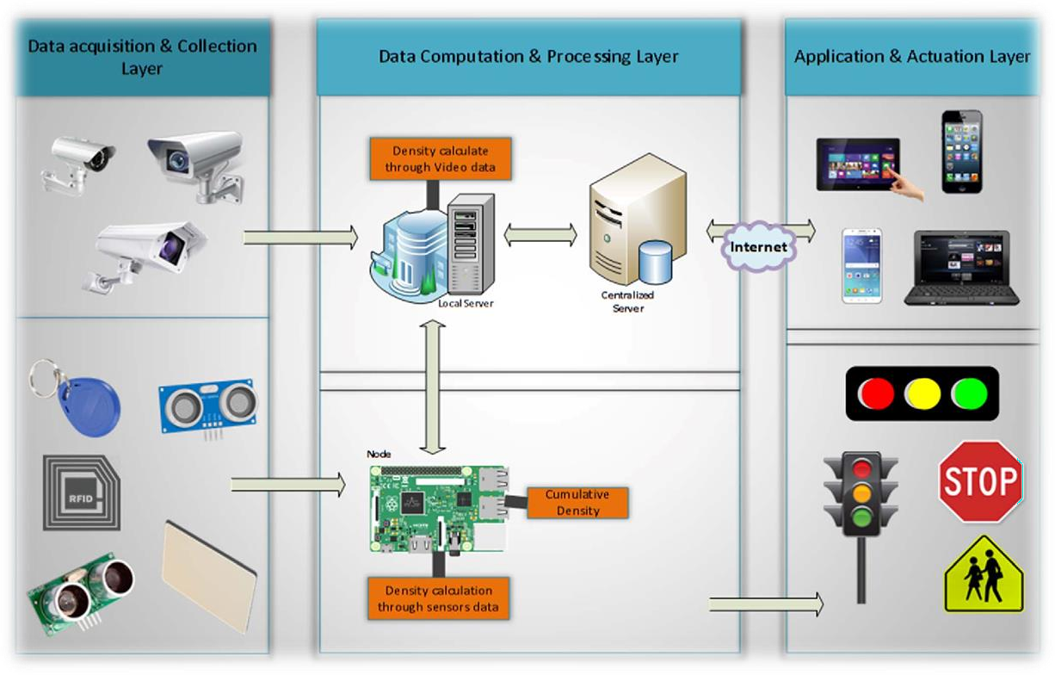
IOT SENSOR SETUP

Slide 4
Step 1: Sensor Selection
Traffic Cameras: Traffic cameras capture real-time images or video of road conditions, includingtraffic flow, congestion, and accidents. They help us visually monitor the road network.
Inductive Loop Sensors: These sensors are embedded in the road surface and detect the presence of vehicles by measuring changes ininductance. They're commonly used at intersections to monitor traffic volume and control traffic signals.
Acoustic Sensors: Acoustic sensors use sound waves to detect vehicle movement and congestion. They can be placed on lampposts or bridges to monitor traffic without physical contact.
Radar Sensors: Radar sensors use radio waves to detect the speed and distance of vehicles. They're useful for monitoring traffic speed and identifying congestion hotspots.
GPS and Mobile Apps: Many vehicles are equipped with GPS devices or use mobile apps with location services. Collecting data from these sources can provide valuable information about traffic patterns and vehicle speeds.

Slide 5
Step 2: Data Collection
Once we've selected our sensors, we need a way to collect data from them. This typically involves setting up a network of IoT devices to transmit data to a central data hub.
Traffic cameras send images or video feeds to a central server.
Inductive loop sensors and acoustic sensors transmit data wirelessly to a central receiver.
Radar sensors and GPS devices have their data transmission capabilities.

Slide 6
Step 3: Data Processing
Now that we're collecting data, we need to process it. This is where the magic happens! We can use machine learning algorithms and data analytics to turn raw data into valuable insights.
We analyze traffic camera images to identify congestion, accidents, and traffic patterns.
Inductive loop sensor data helps us monitor traffic volume and adjust traffic signal timings.
Acoustic sensor data can detect honking or unusual sounds associated with accidents.
Radar data is processed to calculate vehicle speed and density.
GPS and mobile app data provide real-time information on vehicle locations and speeds.

Slide 7
Step 4: Visualization and Control
To make sense of the data, we need user-friendly interfaces. This can include traffic management dashboards, mobile apps, and even electronic road signs. These tools help traffic managers make informed decisions and communicate with drivers.

Slide 8
Raspberry Pi integration
Step 1: Understanding Raspberry Pi
Raspberry Pi is a small, affordable computer that we can use to enhance our traffic management system. It's like a tiny brain that can help us collect and process data from various sensors. Here's how we can integrate Raspberry Pi into traffic management.
Step 2: Sensor Integration
First, we need to connect our Raspberry Pi to the traffic sensors. These sensors could be the ones we mentioned earlier, such as cameras, inductive loop sensors, or even weather sensors. We do this by attaching the sensors to the Raspberry Pi's GPIO pins or using USB connections.
For example, if we have traffic cameras, we connect them to the Raspberry Pi's USB ports. If we're using inductive loop sensors, we connect them to the GPIO pins.

Slide 9
Step 3: Data Collection
Now that our Raspberry Pi is connected to the sensors, it can start collecting data. For traffic cameras, it captures images or videos of the road. For inductiveloop sensors, it records vehicle presence and counts. The data is then stored on the Raspberry Pi's memory.
Step 4: Data Processing
Once we have the data, the Raspberry Pi can process it. We can write programs in languages like Python to analyze the data. For example, we can use image recognition algorithms to detect traffic congestion in camera images or calculate traffic density from inductive loop sensor data.
Step 5: Data Storage
To ensure we don't lose any important data, we can also connect the Raspberry Pi to external storage devices, like external hard drives or cloud storage. This way, we have a backup of all the traffic data we collect.

Slide 10
MOBILE APP DEVELOPMENT
Step 1: User Interface Design:
Now, let's work on the user interface (UI) design. This is crucial because our app needs to be user-friendly. We'll design screens for features like real-time maps, incident reporting, and navigation.
Step 2: Data Integration:
To provide real-time traffic information, we'll integrate our app with data sources like traffic cameras, GPS data, and government traffic feeds. This will ensure our users get accurate and up-to-date information.
Step 3: Core Features Development:
Real-Time Traffic Data: We'll develop the functionality to collect and display real-time traffic conditions on a map, including congestion, accidents, and road closures.
Navigation: We'll integrate GPS navigation with real-time traffic updates, suggesting alternate routes to avoid congestion.
Incident Reporting: Users will be able to report incidents, such as accidents or potholes, by uploading photos and adding location tags.

Slide 11
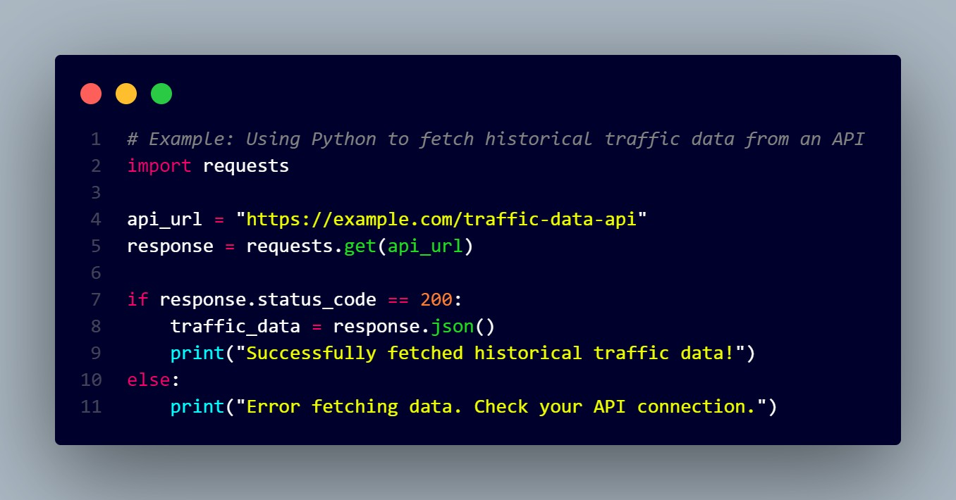
CODE IMPLEMENTATION
Step 1: Collecting Historical Traffic Data
The first thing we need to do is gather historical traffic data. This data will be our foundation for predicting congestion patterns. We can use APIs or databases provided by transportation authorities or third-party sources to get this data.

Slide 12
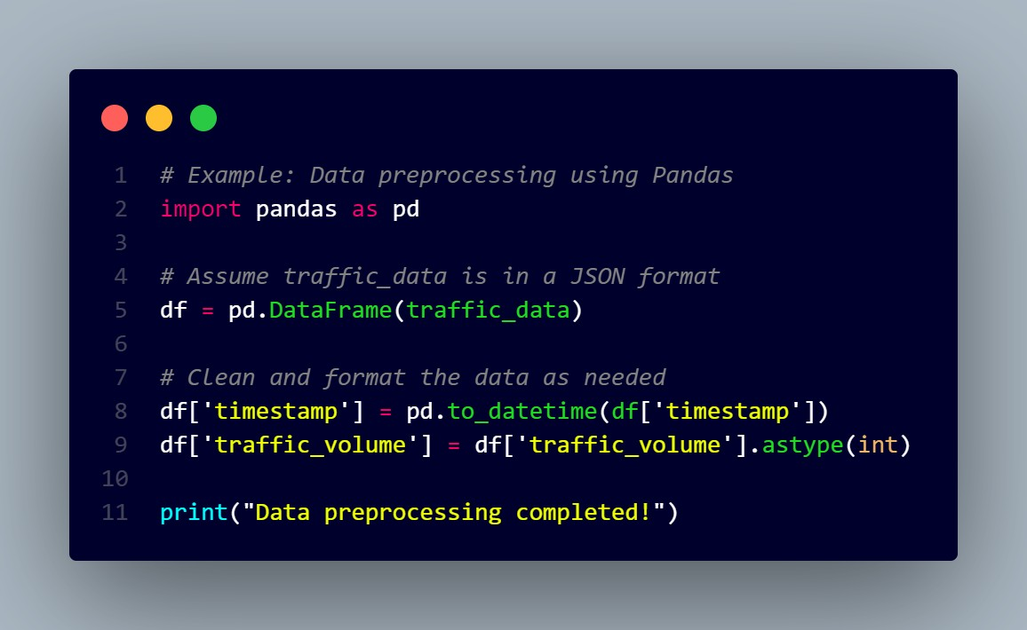
Step 2: Data Preprocessing
Now, let's prepare the data for our machine-learning model. This involves cleaning, transforming, and structuring the data so it's suitable for analysis.

Slide 13
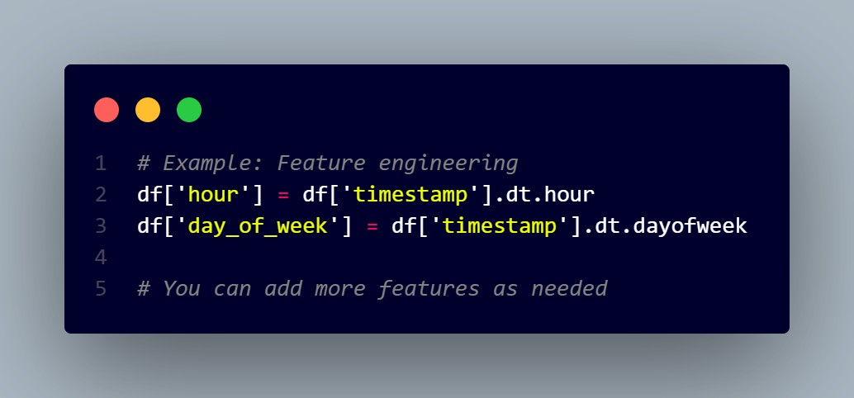
Step 3: Feature Engineering
Next, we need to create relevant features from our data that will help our machine- learning model make predictions. This could include things like time of day, day of the week, weather conditions, and more.

Slide 14
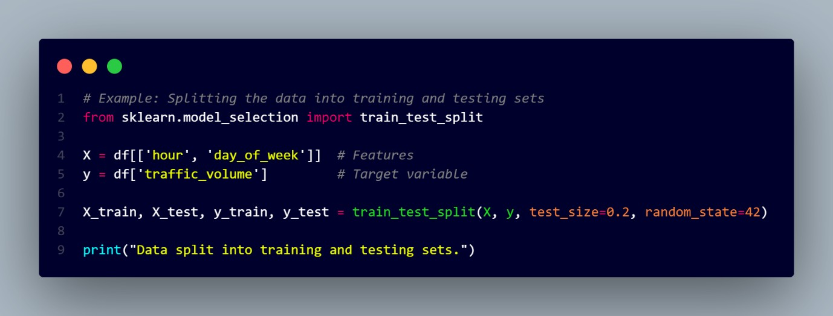
Step 4: Splitting the Data
We should split our data into training and testing sets to evaluate the model's performance.

Slide 15
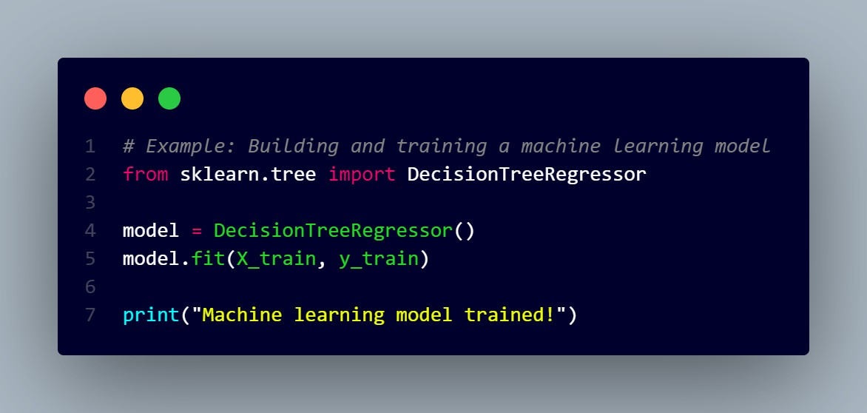
Step 5: Building a Machine Learning Model
Now, let's create and train a machine-learning model. In this example, we'll use a simple decision tree regressor.

Slide 16
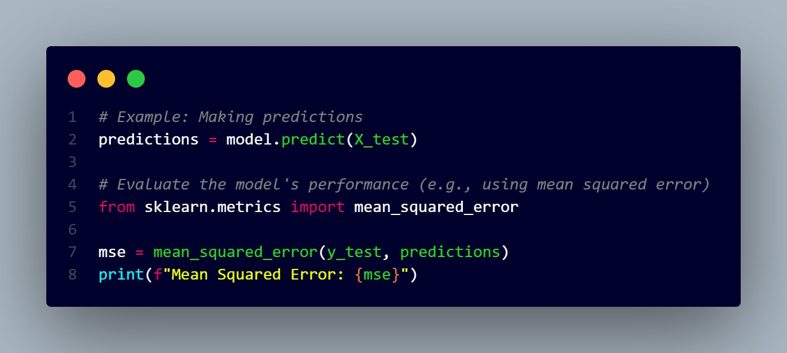
Step 6: Making Predictions
Finally, we can use our trained model to make predictions on congestion patterns.

Slide 17
THANK YOU

